Slide 1
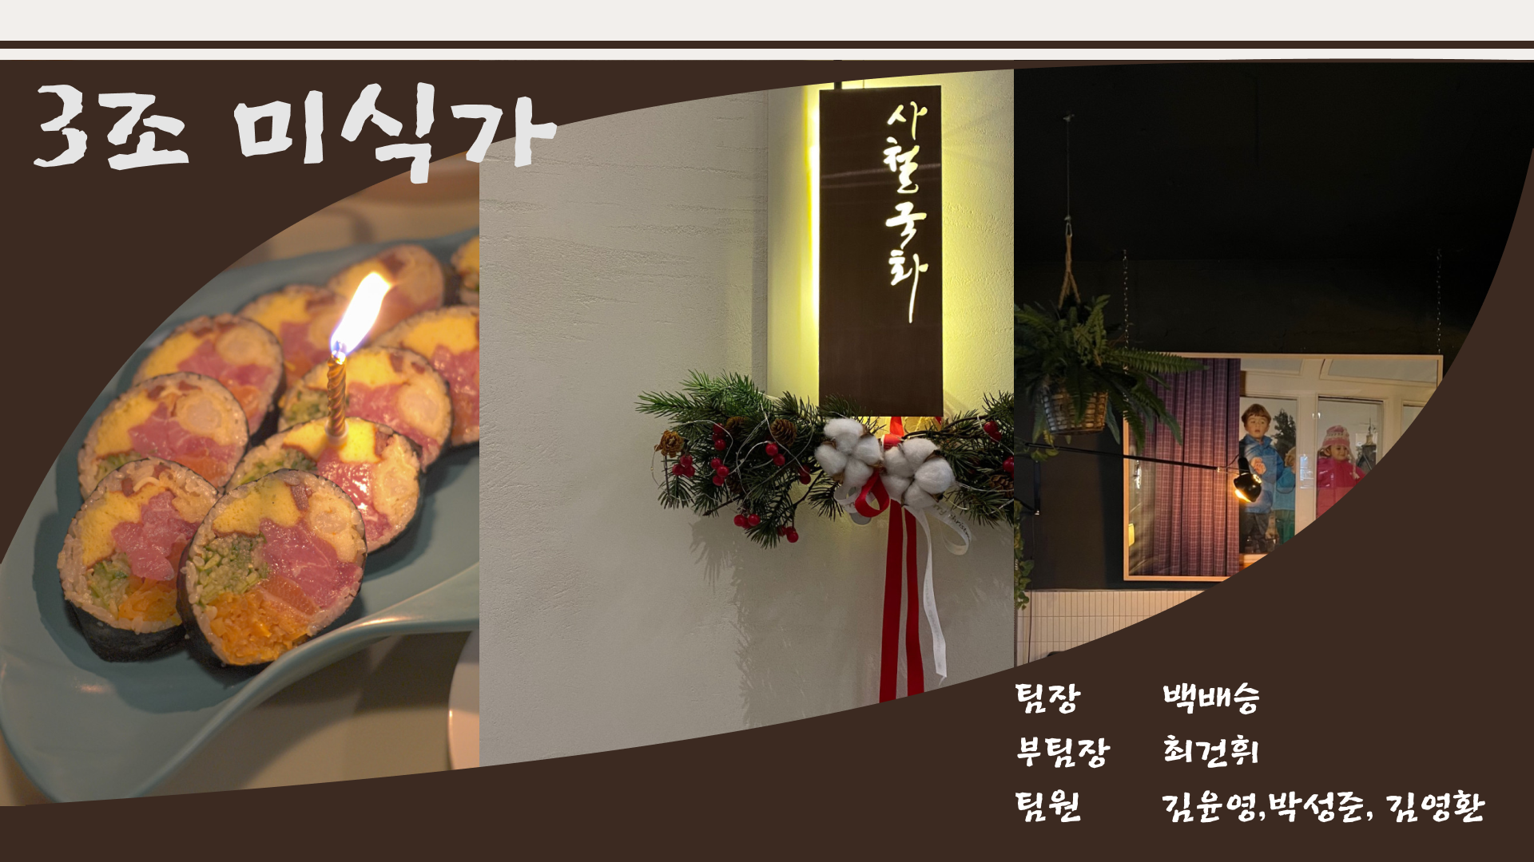

Slide 2
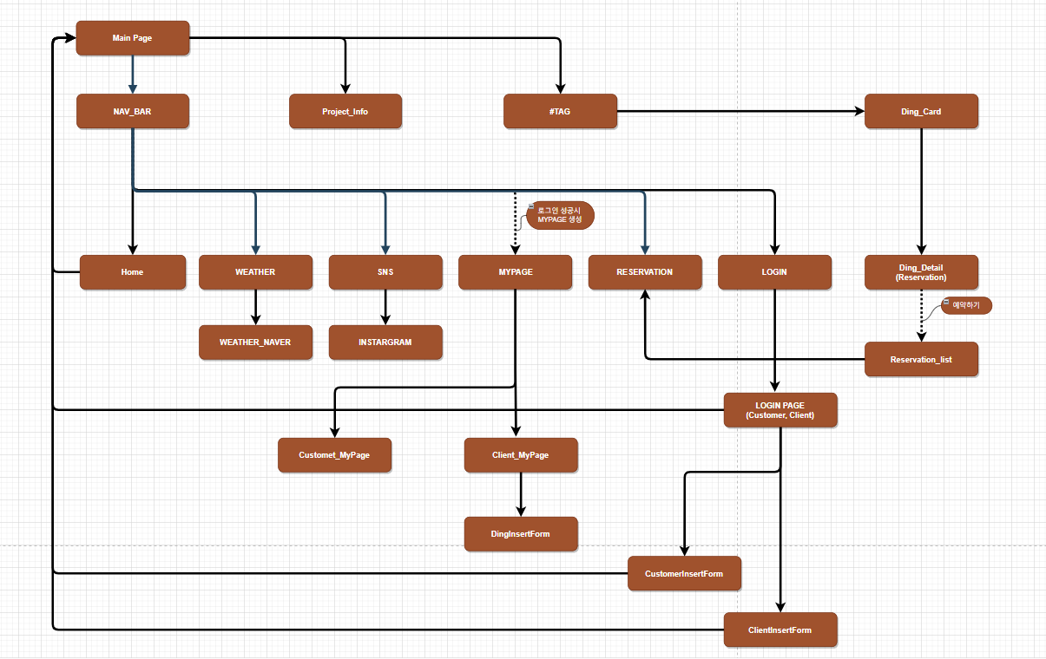

Slide 3
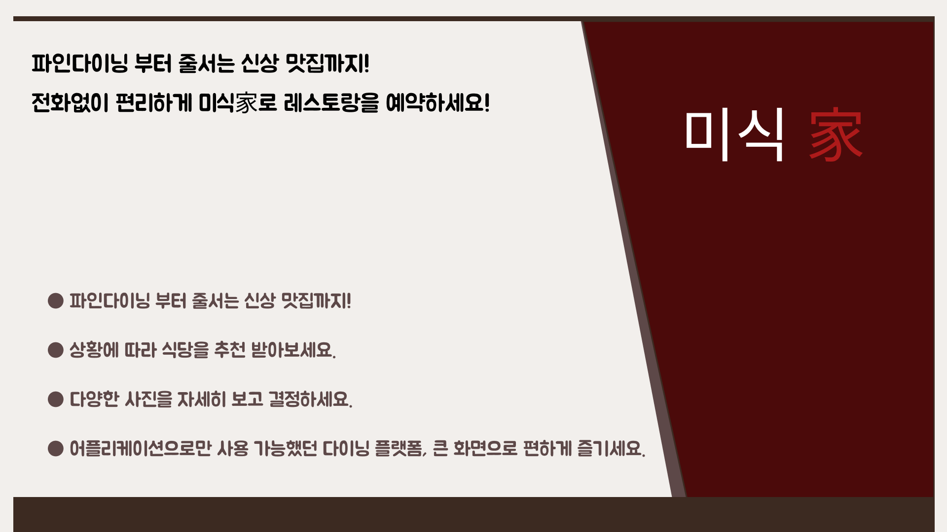

Slide 4
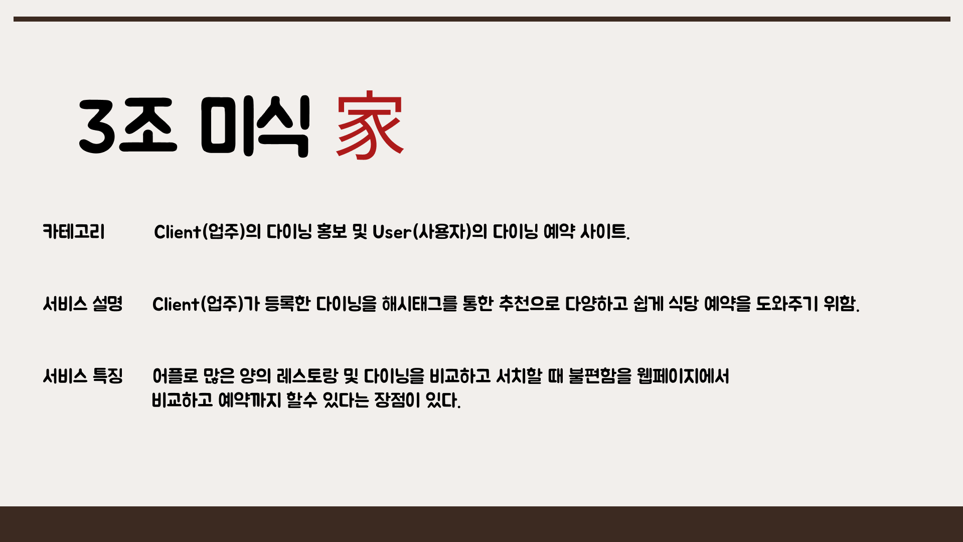

Slide 5
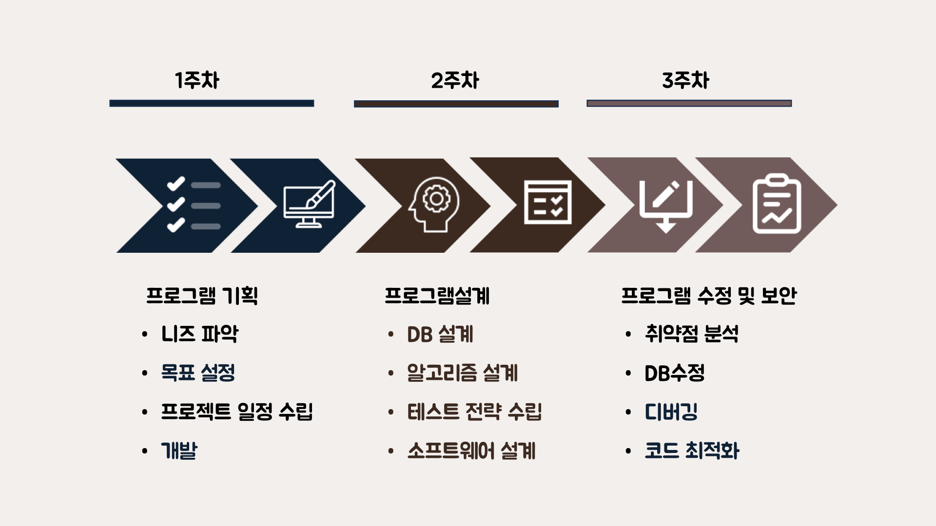

Slide 6
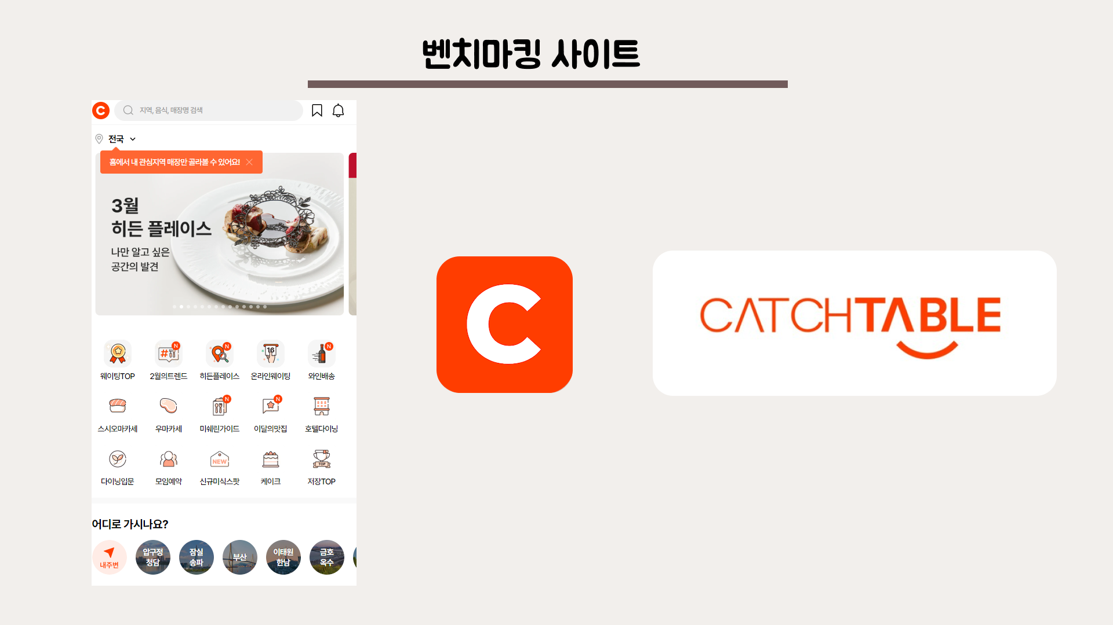

Slide 7
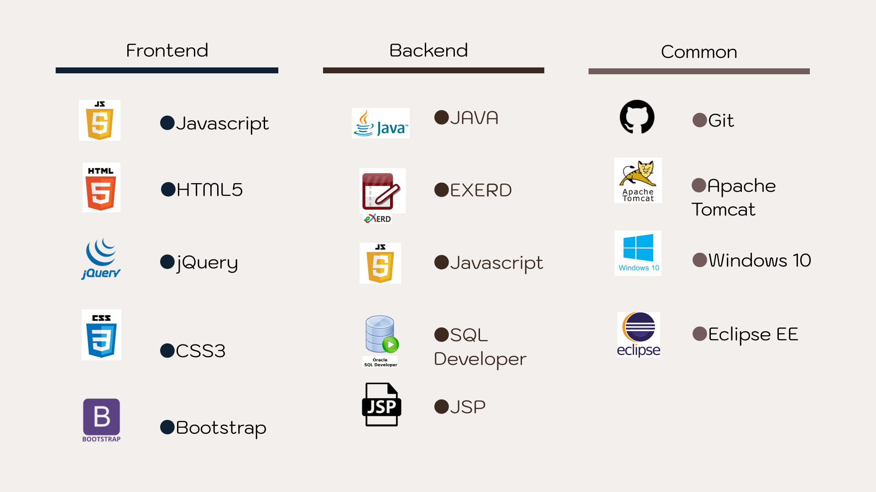

Slide 8

>> Todolist.
# User section
--User 회원가입
CustomerInsert=com.dining.controller.User.UserInsertController
--로그인
CustomerLogin_MainPage=com.dining.controller.User.UserLoginController
CustomerLogin=com.dining.controller.User.UserLoginController
--회원 정보 수정
CustomerUpdate=com.dining.controller.User.UserUpdateController
--로그아웃
CustomerLogout=com.dining.controller.User.UserLogoutController
--회원 탈퇴
CustomerDelete=com.dining.controller.User.UserDeleteController
CustomerDeleteDetail=com.dining.controller.User.UserDeleteDetailController
CustomerGotoDelete=com.dining.controller.User.UserGotoDeleteController
--아이디 중복체크
CustomerIdCheck=com.dining.controller.User.CustomerIdCheckController

Slide 9
>> Todolist.
# Client section
--클라이언트 회원가입
ClientInsert=com.dining.controller.client.ClientInsertController
--클라이언트 로그인
ClientLogin_MainPage=com.dining.controller.client.ClientLoginController
ClientLogin=com.dining.controller.client.ClientLoginController
--회원정보 수정
ClientUpdate=com.dining.controller.client.ClientUpdateController
--회원 탈퇴
ClientLogout=com.dining.controller.client.ClientLogoutController
--아이디 중복 체크
clientIdCheck=com.dining.controller.client.clientIdCheckController

Slide 10
>> Todolist.
# Dining section
#DiningList=com.dining.controller.dining.DiningListController
--다이닝 정보 입력
DiningInsert=com.dining.controller.dining.DiningInsertController
DiningGotoInsert=com.dining.controller.dining.DiningGotoInsertController
# Reservation section
--예약 입력
ReservationInsert=com.dining.controller.reservation.ReservationInsertController
--예약 내역 리스트
ReservationHistory=com.dining.controller.reservation.ReservationHistoryController
ReservationHistoryDelete=com.dining.controller.reservation.ReservationHistoryDeleteController

Slide 11
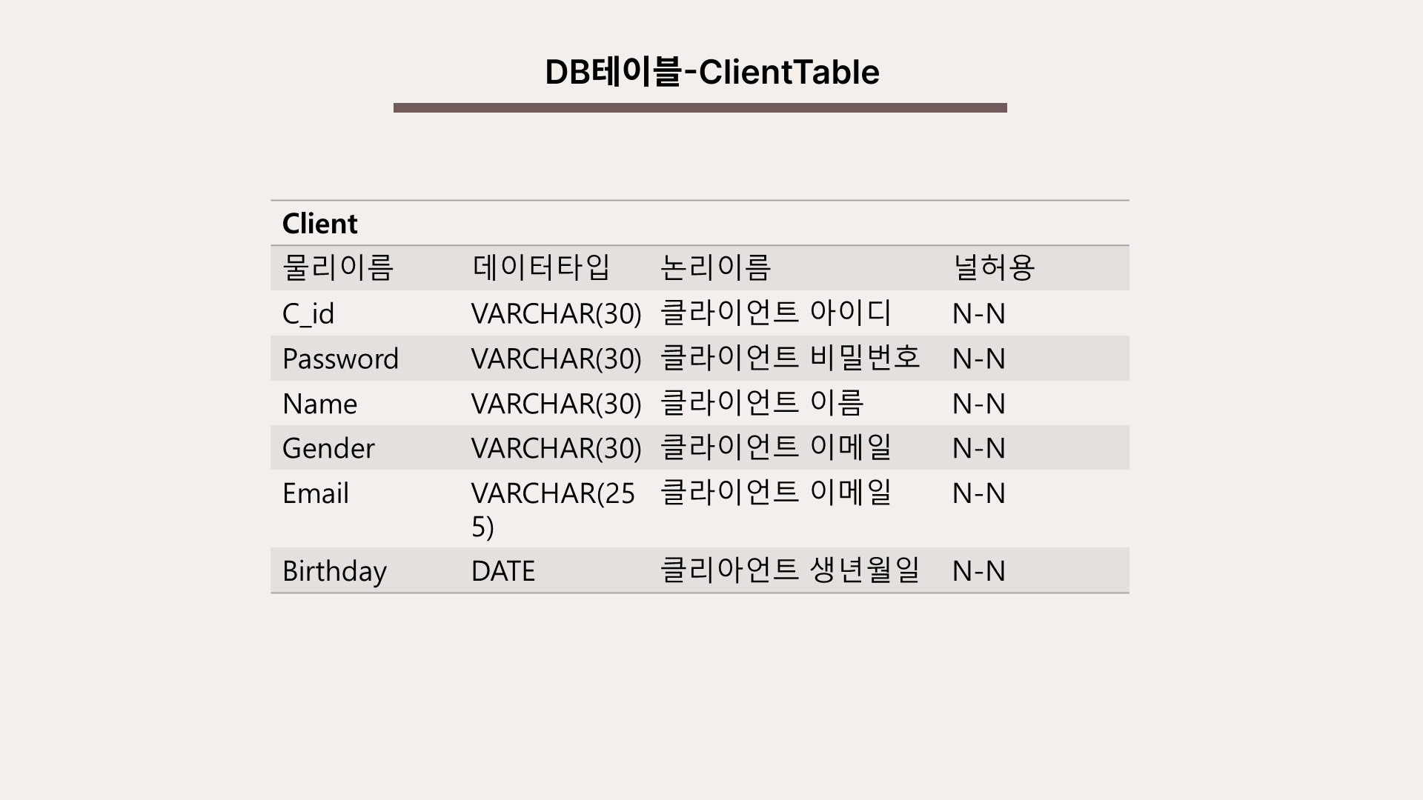

Slide 12
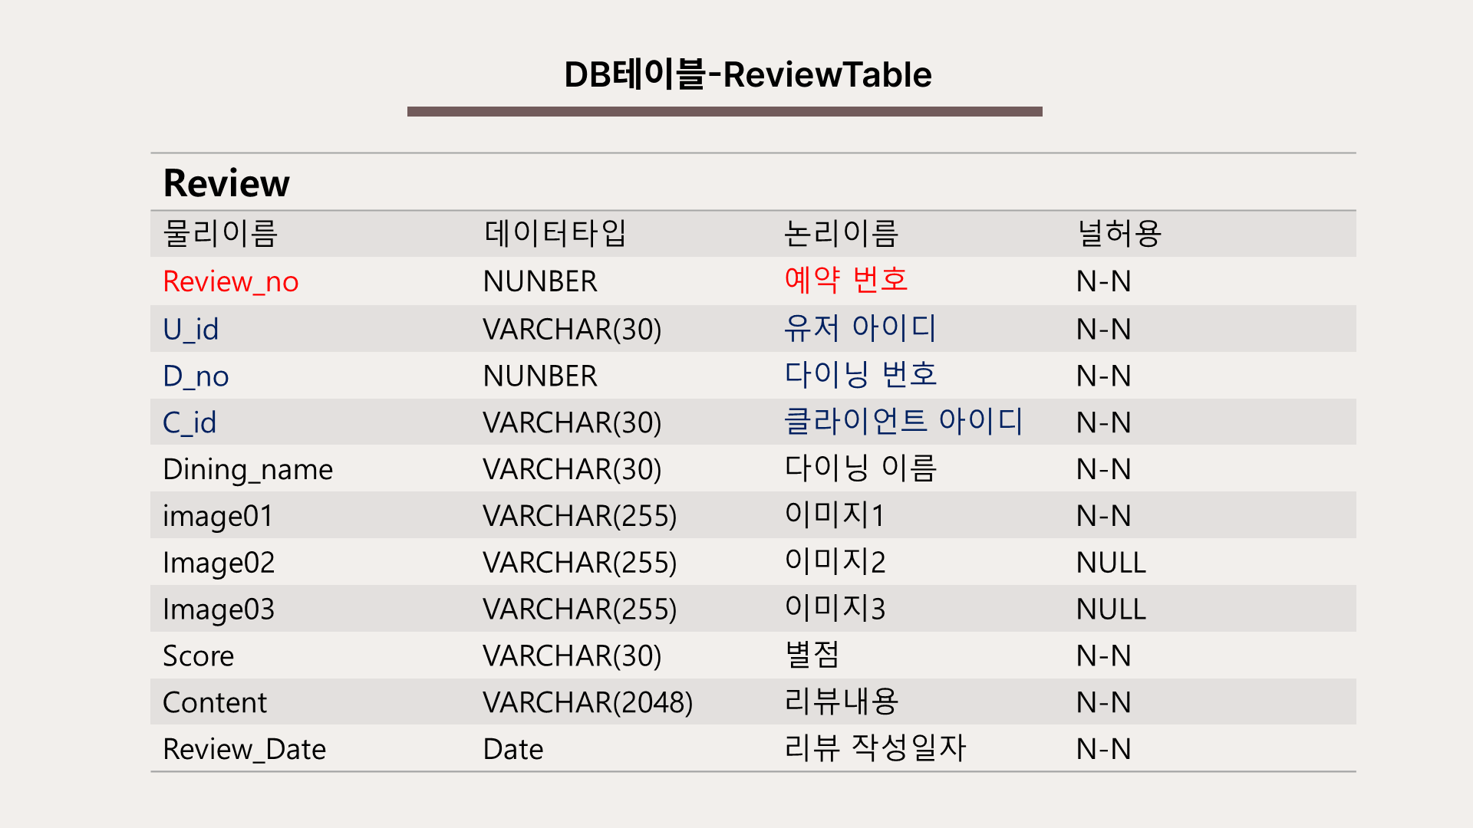

Slide 13
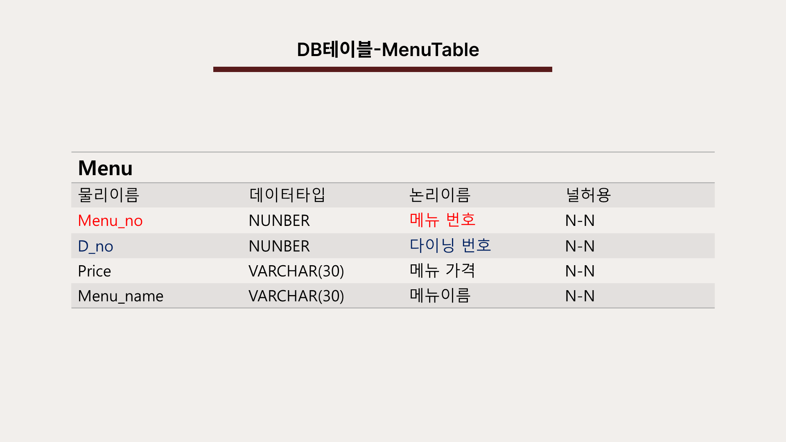

Slide 14
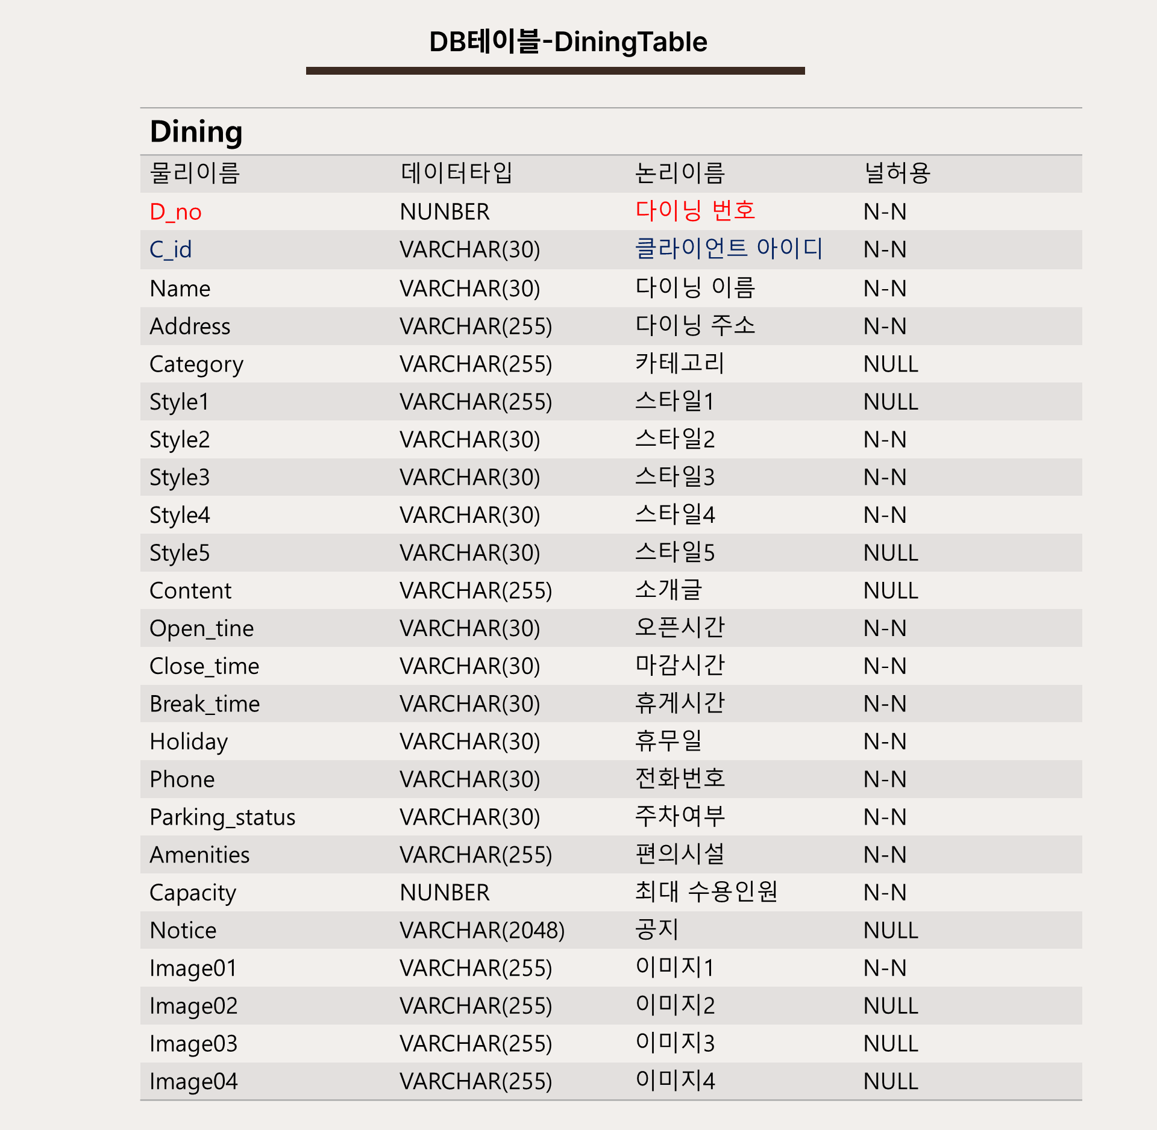

Slide 15
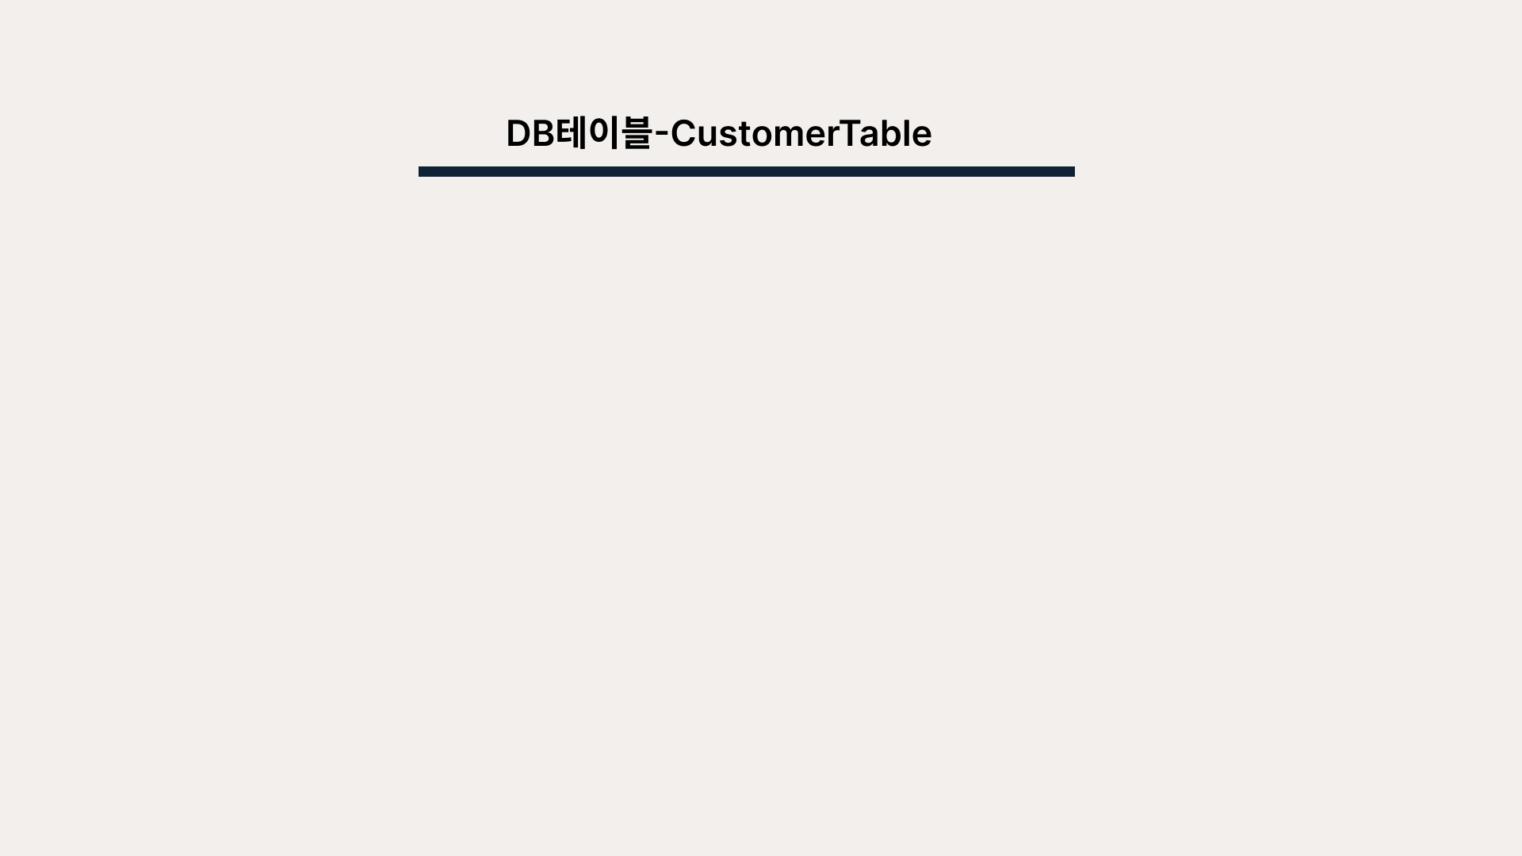
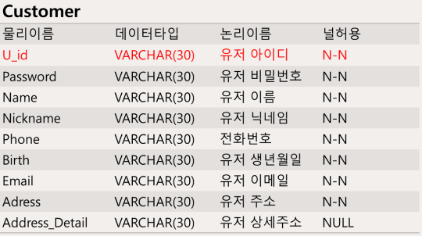

Slide 16
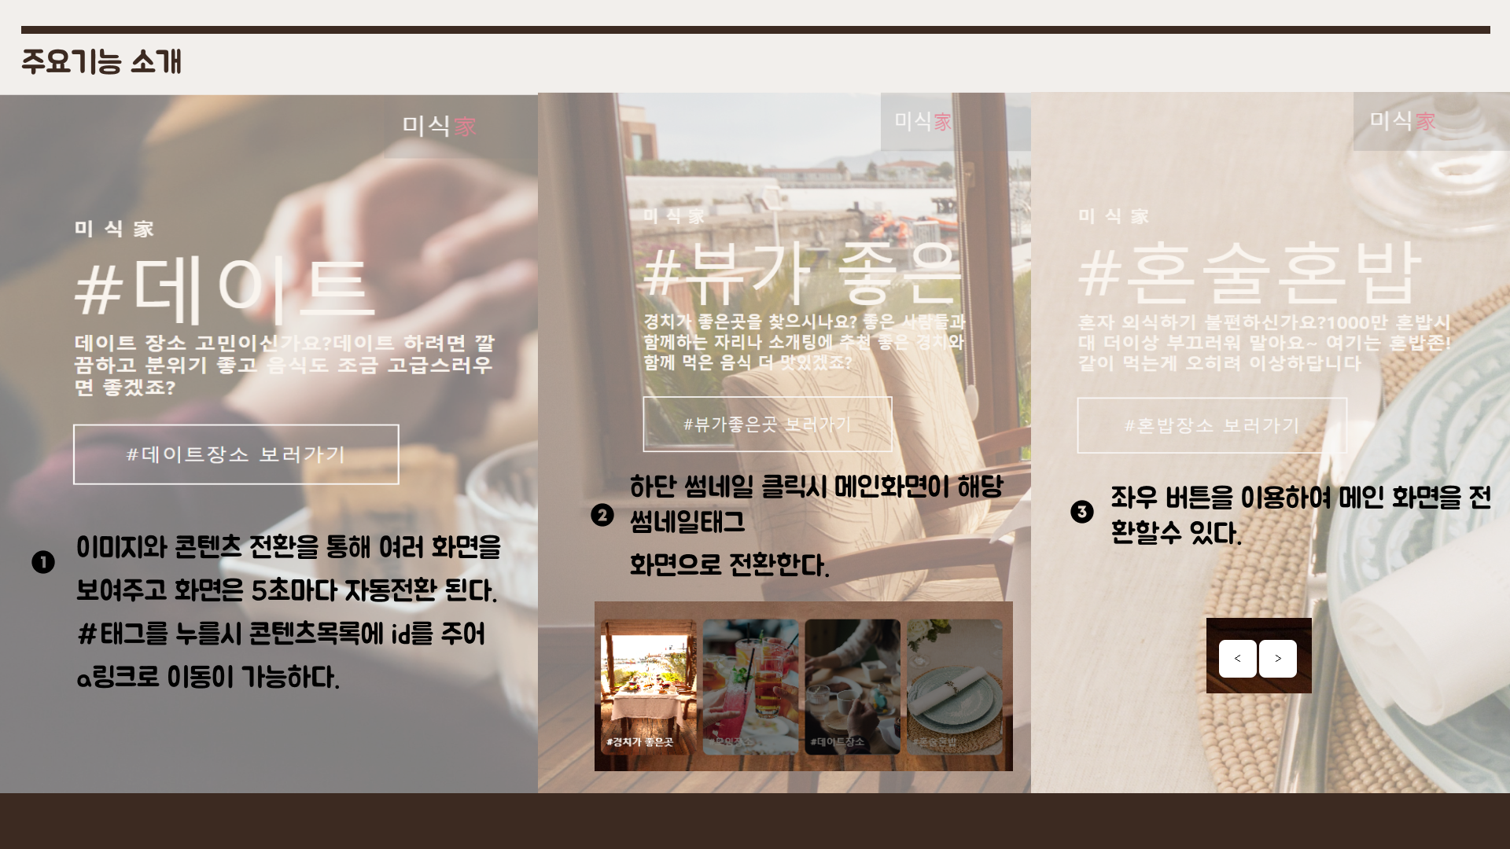

Slide 17
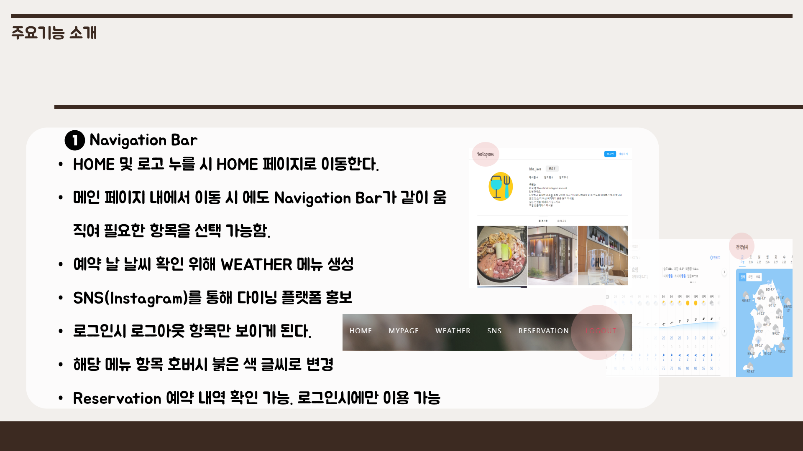

Slide 18
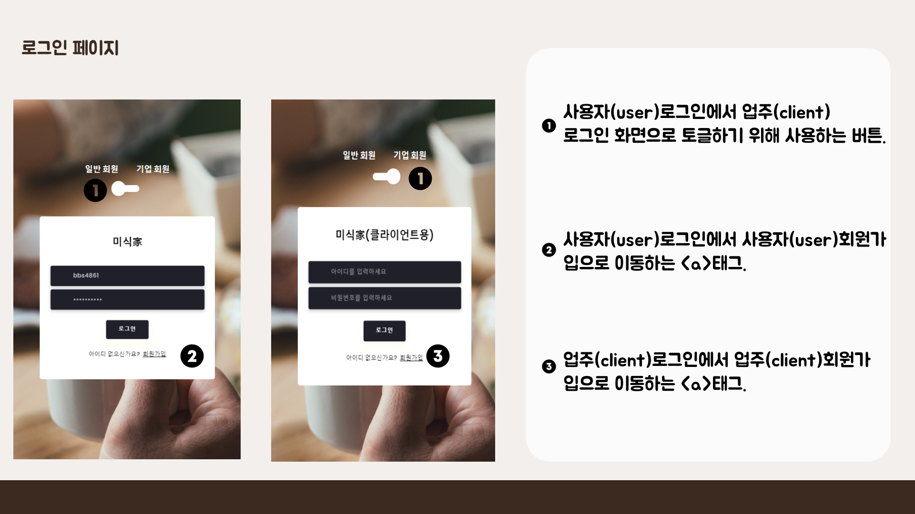

Slide 19
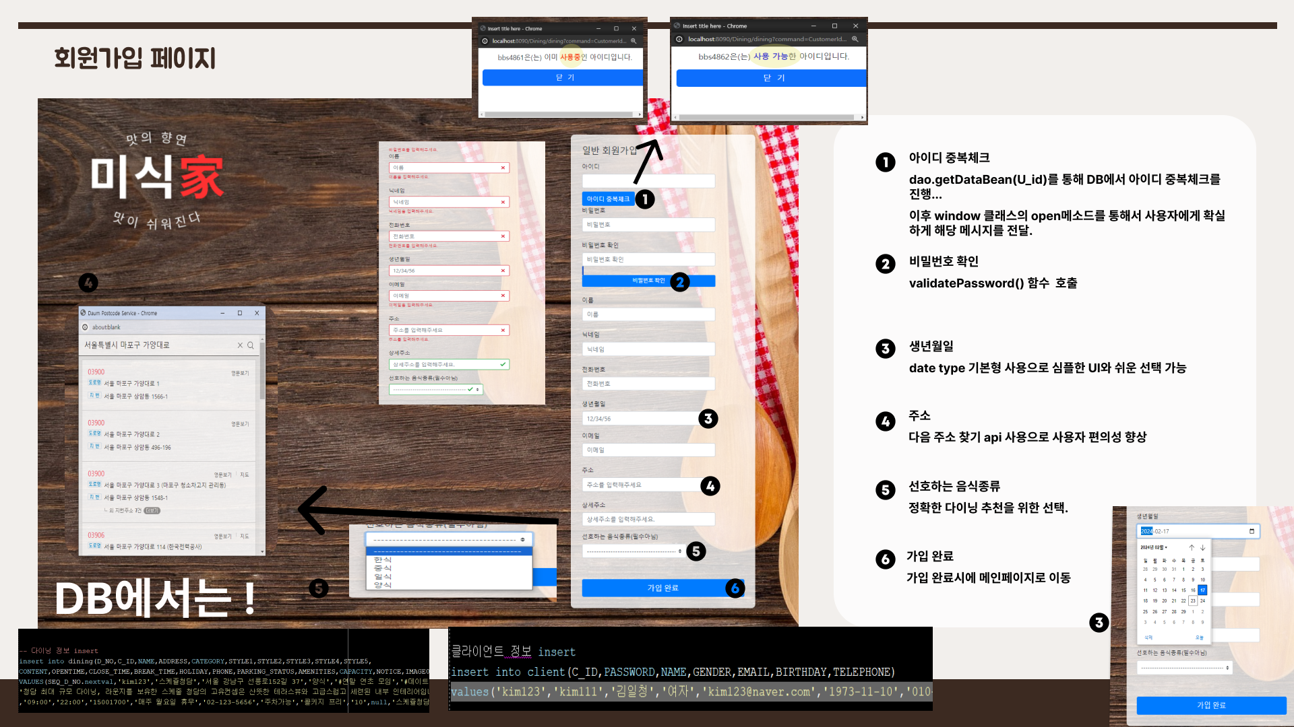

Slide 20
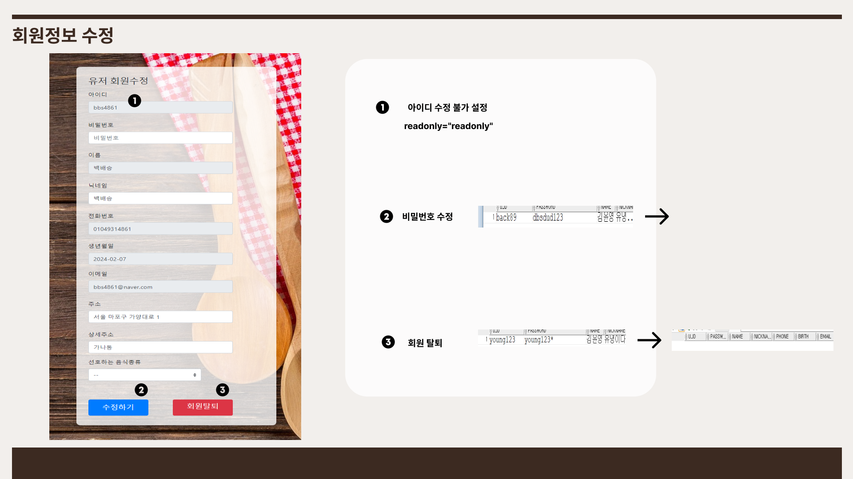

Slide 21
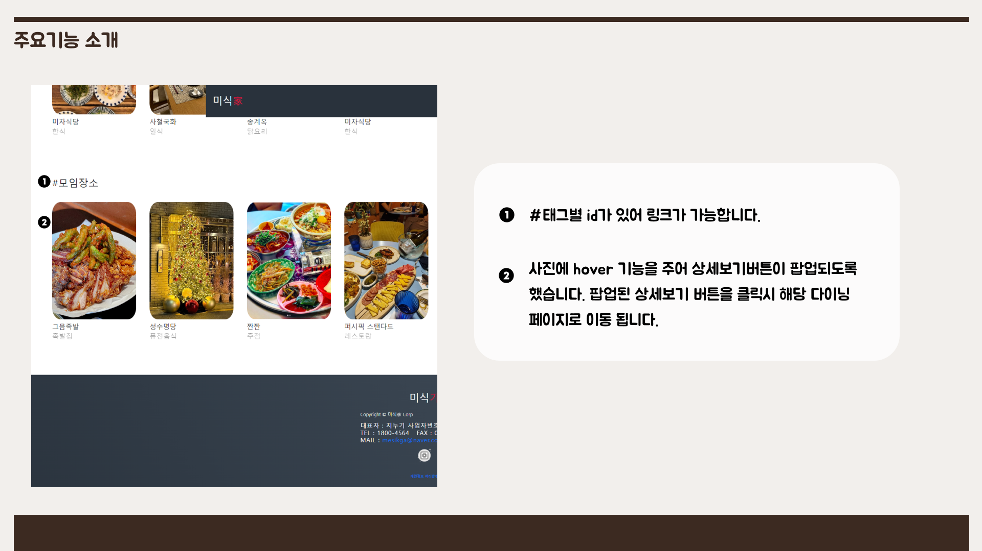

Slide 22
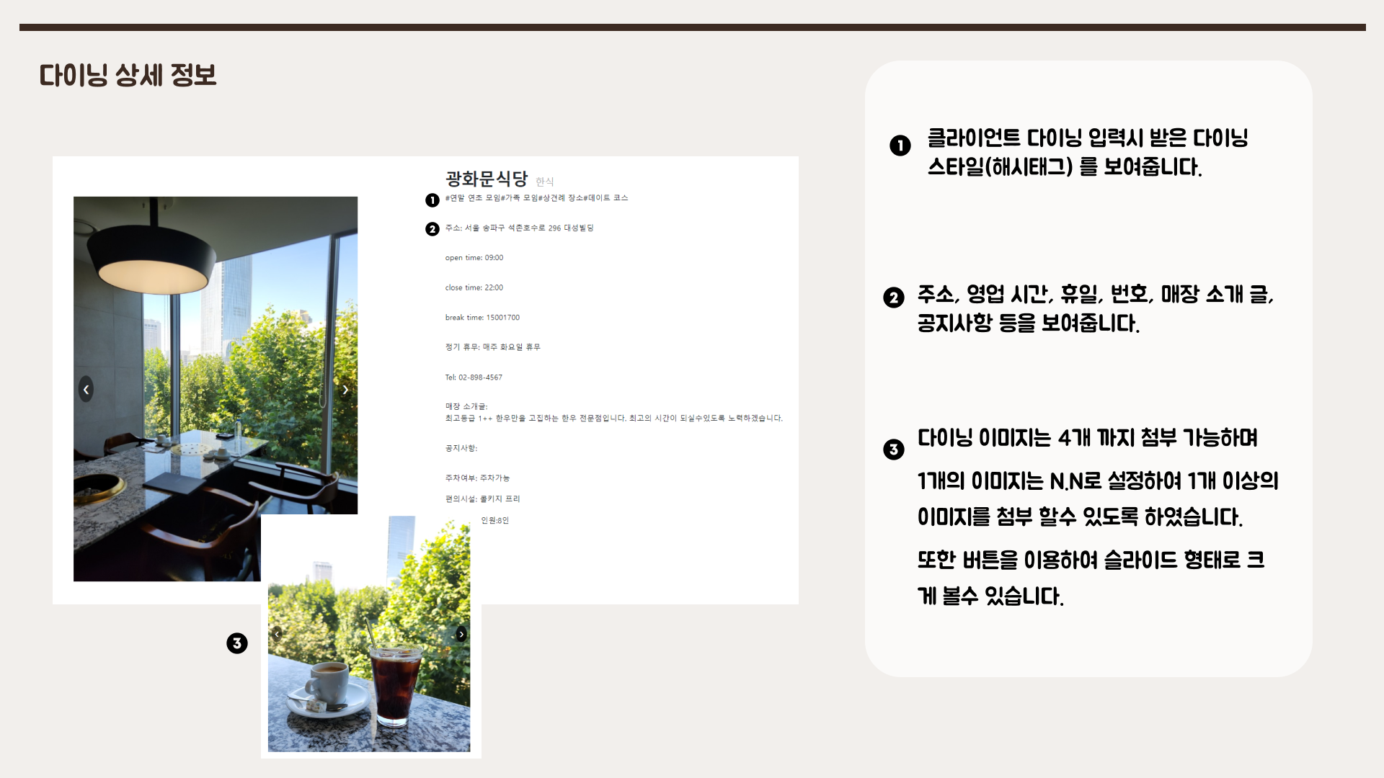

Slide 23
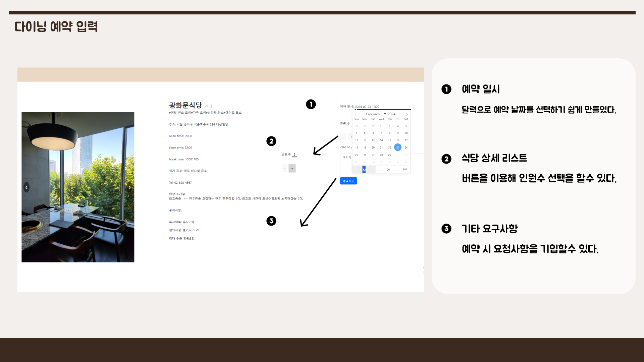

Slide 24
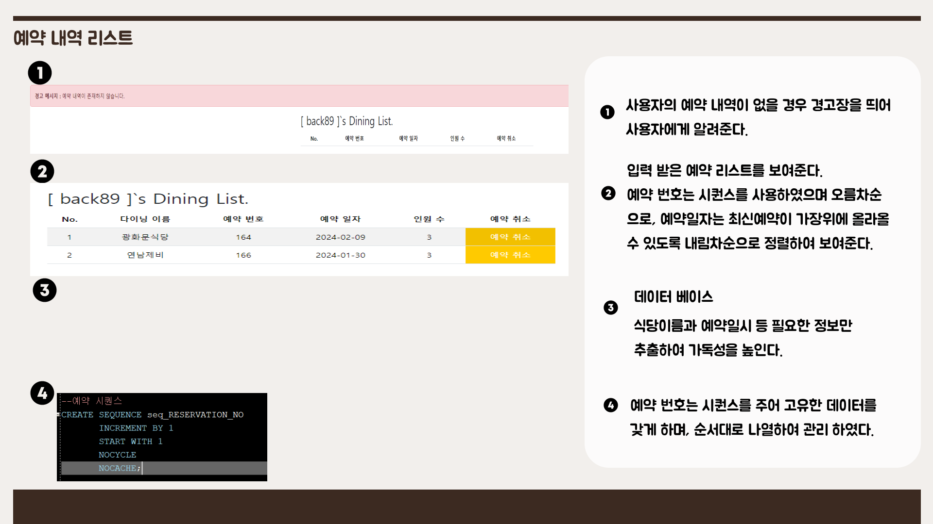
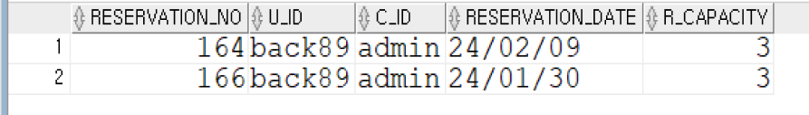

Slide 25
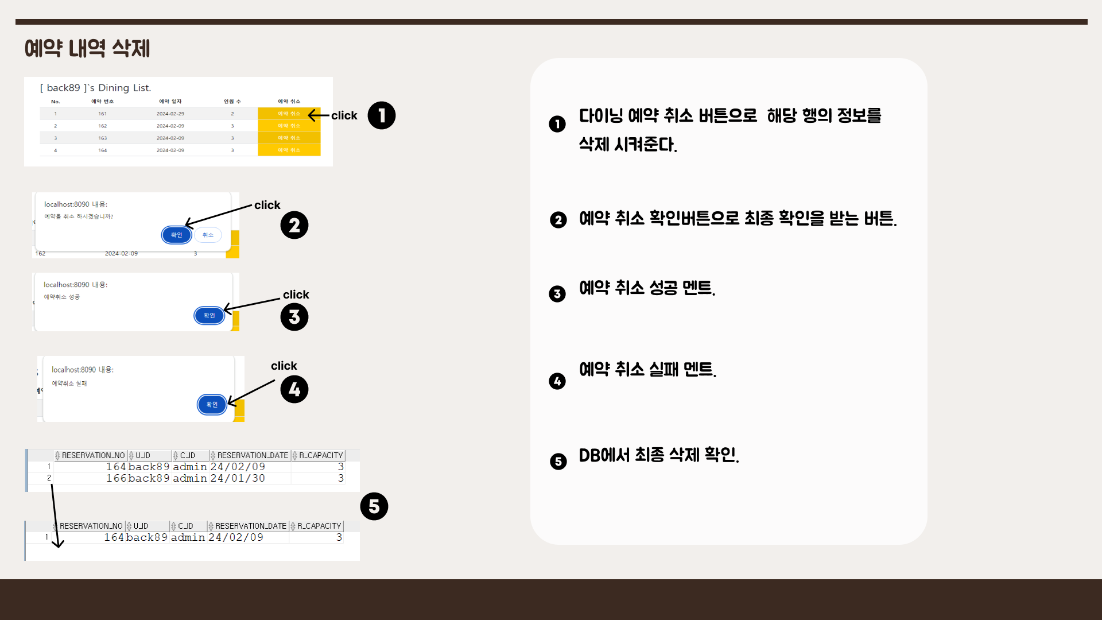

Slide 26
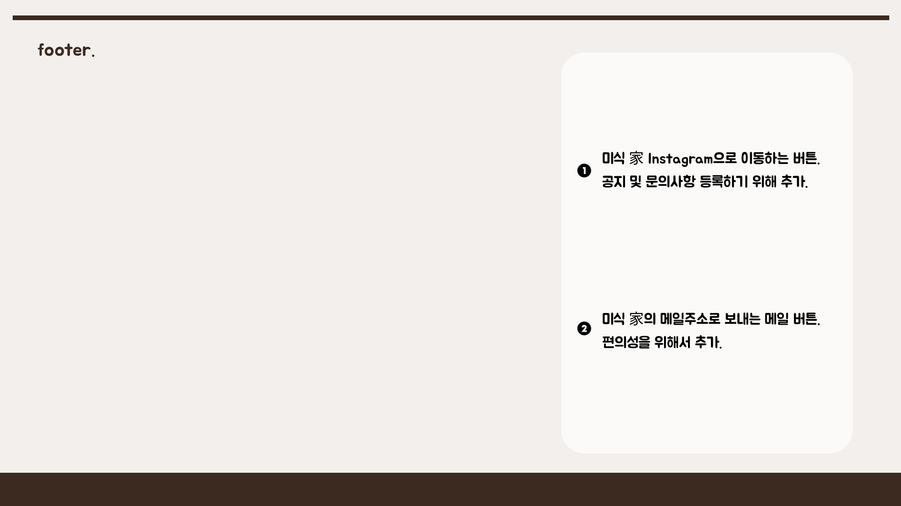
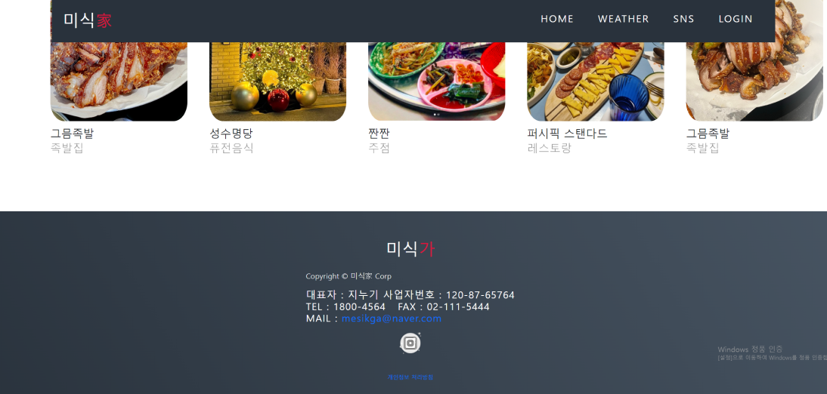

Slide 27
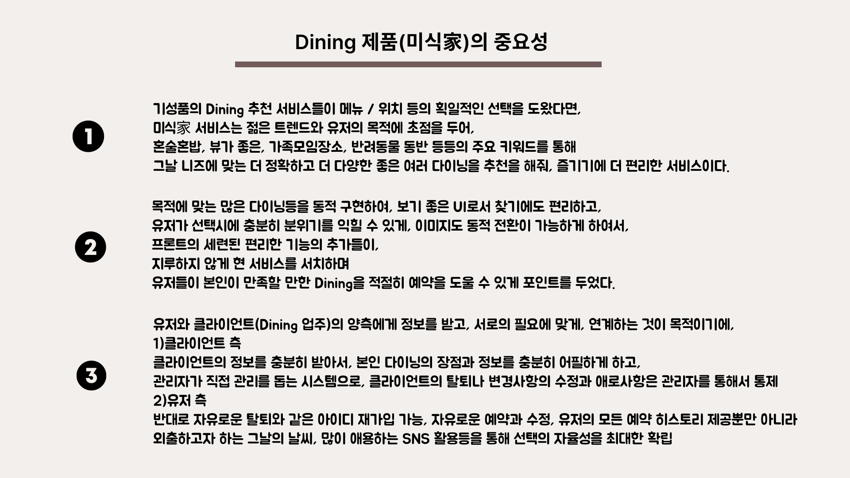

Slide 28
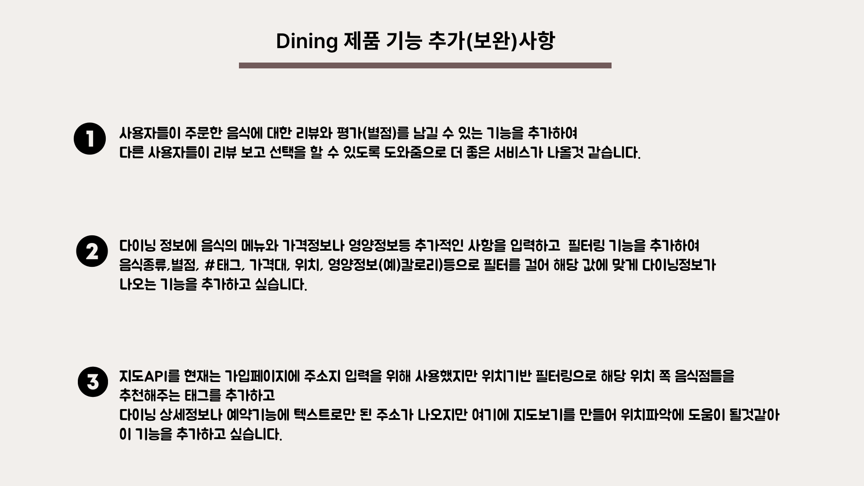

Slide 29
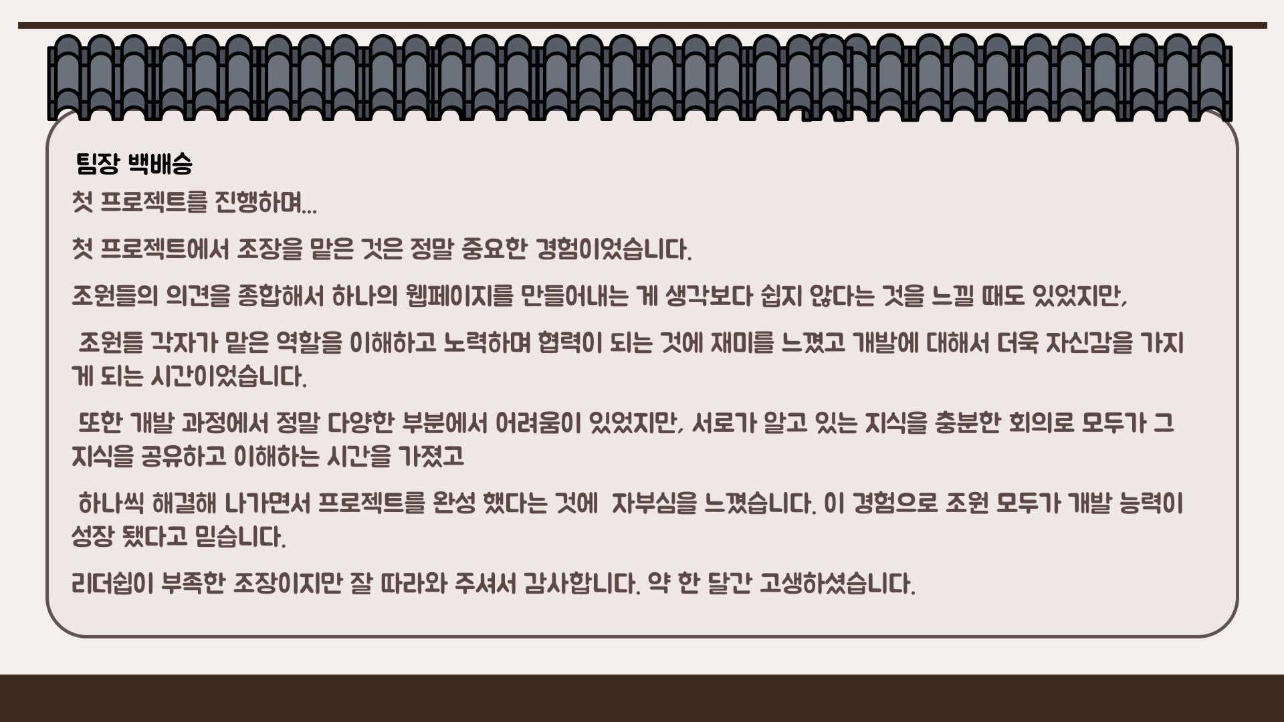

Slide 30
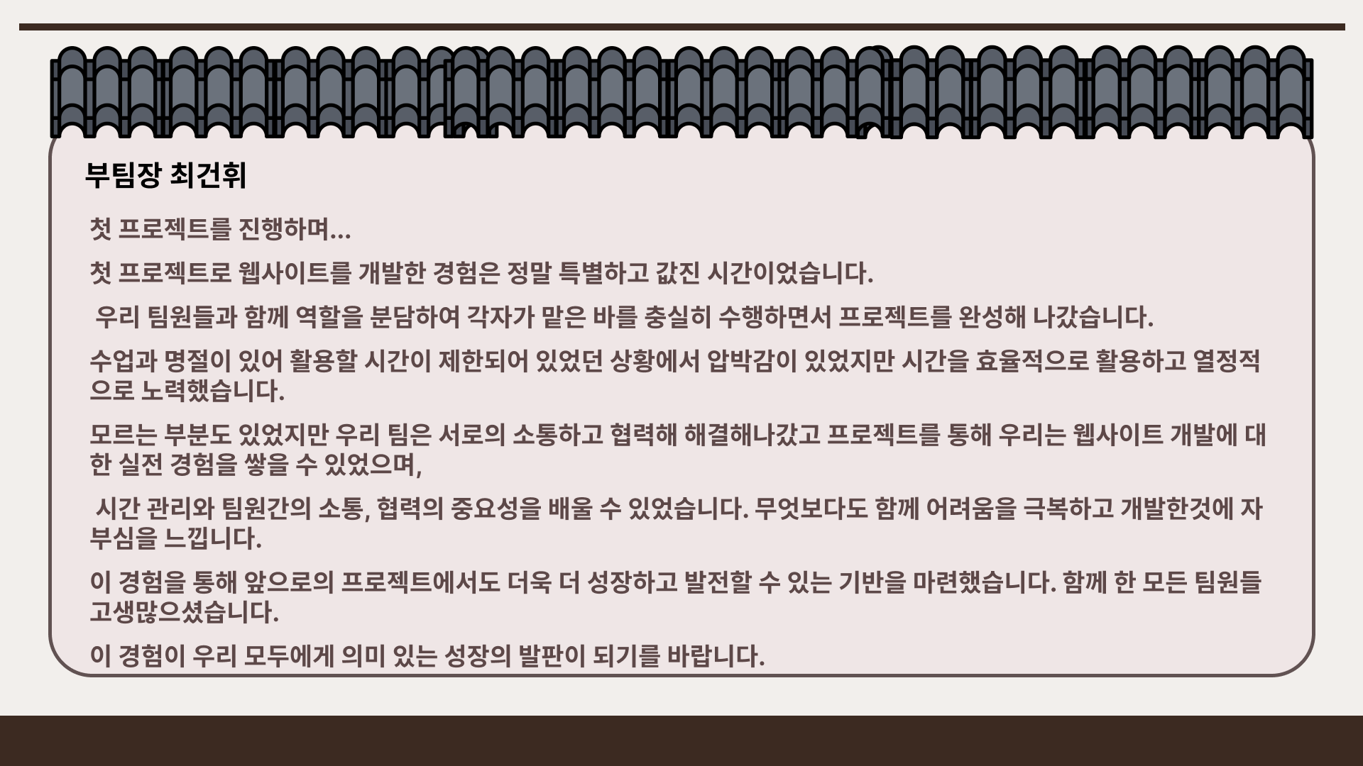

Slide 31
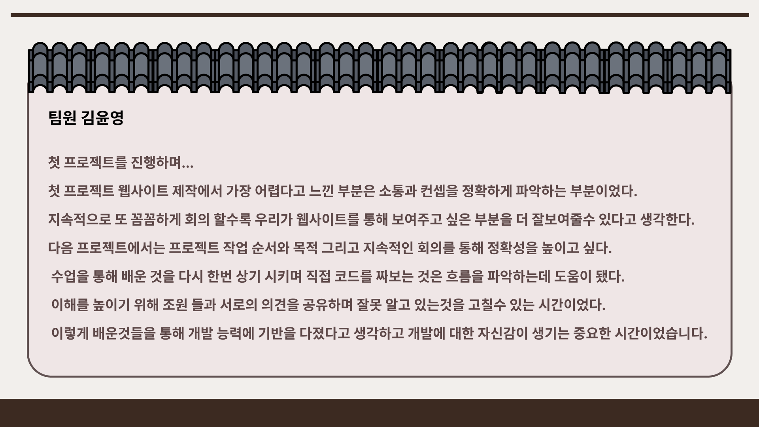

Slide 32
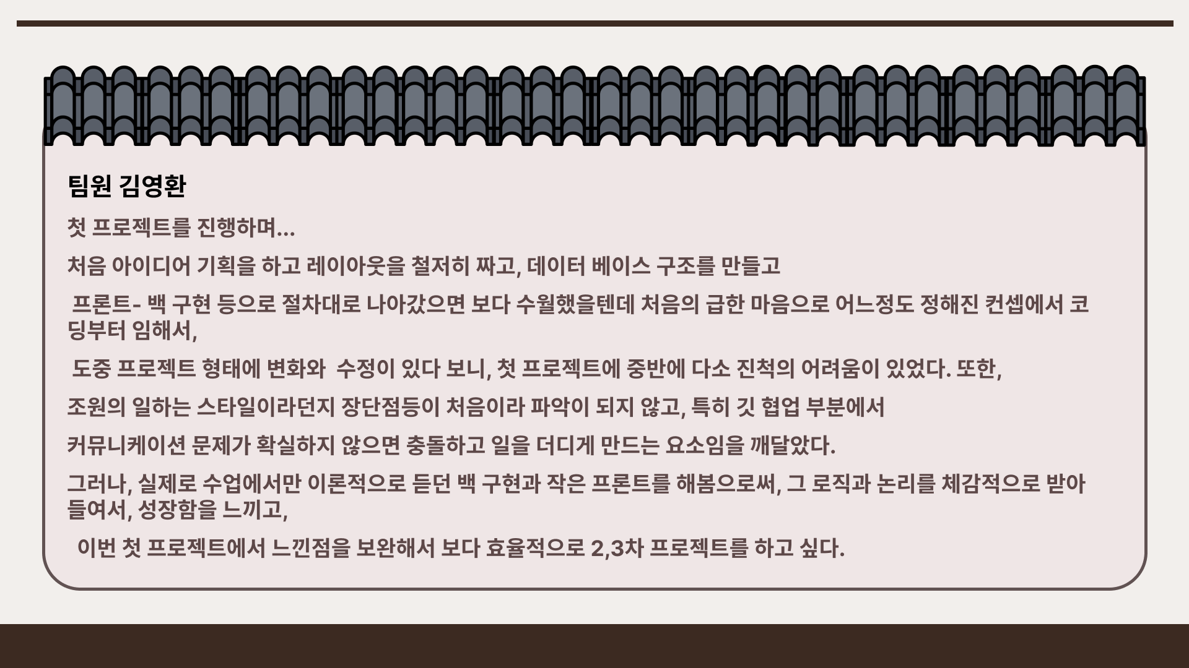

Slide 33
